Slide 1
Tecumseh (tuh-come-suh)
Shawnee Indian chief, orator, military leader, native American activist

Slide 2
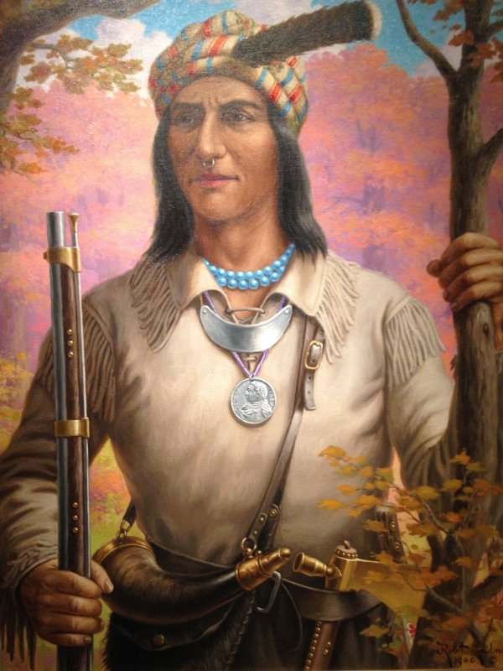

Slide 3
Tecumseh (tuh-come-suh)
Born 09March1768 on Mad River, Old Piqua, (pick-wey) now Clark County, Ohio, United States

Slide 4
Died 05October1813 Thames River, Upper Canada, now Chatham,
(chat-um) Ontario, Canada in battle during War of 1812

Slide 5
The original name Tecumtha or Tikamthi means “One who passes across intervening space from one point to another,” i. e. springs

Slide 6
The name indicates that the owner belongs to the generations of the Great Medicine Panther, or Meteor
Nicknamed “Crouching Panther” and “Shooting Star”

Slide 7
His father was called Puckeshinwa (puck-a-shine-way)
His mother was called Methotaske (meth-ah-task)

Slide 8
His father, who was also a chief, was killed at the battle of Point Pleasant in 1774 during Lord Dunmore’s War
His mother, a Muskogee (Creek Confederacy), left him, when he was seven years old, to go with the tribe to Missouri

Slide 9
His father’s death had a lasting effect on Tecumseh
He vowed to become a warrior like his father
As a teenager he joined the American Indian Confederacy under the leadership of Mohawk Chief Joseph Brant

Slide 10
He worked with his brother Tenskwatawa, (tens-squat-ah-wah) known as “The Prophet”
They tried to unite American Indian tribes in the Northwest Territory to defend against white settlers

Slide 11
Tecumseh led a group of raiders in these efforts, attacking American boats trying to make their way down the Ohio River
He cut off river access to the territory for a time

Slide 12
He defeated General Arthur St. Clair and his army at the Battle of the Wabash in 1791

Slide 13
Tecumseh fought under Blue Jacket and Little Turtle
The American Indian Confederacy was victorious slaying 952 American soldiers

Slide 14
Tecumseh fought in the Battle of Fallen Timbers (1794) against General Anthony Wayne (American forces)
It was a defeat for the American Indian Confederacy

Slide 15
Tecumseh and others went to a place that later became known as Prophetstown (i.e. Tippecanoe in Indiana Territory) creating a new pan-Indian alliance

Slide 16
In 1808 the two men began recruiting a large multi-tribal community of followers under a message of resistance to settlers

Slide 17
William Henry Harrison, governor of Indiana Territory negotiated treaties
Harrison used American forces to pressure the tribes still in Indiana and those allied with Prophetstown

Slide 18
The Treaty of Fort Wayne (1809) gave the settlers a lot of American Indian territory
Harrison launched a sneak attack on the Indians known as the Battle of Tippecanoe

Slide 19
Tecumseh and his confederacy sided with the British in the War of 1812
Tecumseh overtook the city of Detroit

Slide 20
Major-General Proctor fought Tecumseh at the Thames River
500 American Indians against 3,000 Americans

Slide 21
Tecumseh was fatally wounded in the battle
It is unknown who killed him or what happened to his remains

Slide 22
Tecumseh’s death began the American Indian resistance to settler encroachment
The War of 1812 marked the end of Indian resistance in the Midwest and Ohio River valley

